Slide 1


311 NYC
PROJECT BY:
ASMA BATOOL
NAVYA VEMURI
SHUBHAM KISAN
MUKESH LAUDYA

Slide 2



Agenda
INTRODUCTION
PROBLEM DEFINITION
DATASET USED
VIZUALIZATION
RESULT
CONCLUSION

Slide 3


Introduction
The goal of NYC 311 is to deliver the finest level of customer care while enabling rapid and simple access for the general public to all New York City government services and information. Thousands of requests for hundreds of different non-emergency services, such as complaints about noise, plumbing problems, and illegally parked cars, are sent to NYC311 every single day. NYC311 receives these requests and sends them on to the appropriate departments, such as the police, buildings, or transportation. The request is responded to, dealt with, and then closed by the agency.

Slide 4



PROBLEM DEFINITION
The data from 311 Service Requests in New York city from January 2022 to the present date contains on how many service requests have been requested and in which places the most complaint requests has been raised and what type of complaints has been registered frequently and at last how fast they have been resolved the issue and may more . This analysis may be helpful for the services to get better understanding on which problem they should focus on.

Slide 5
DATA SET USED
NEWYORK CITY
311
Service Requests from
NYC open data website

Slide 6
OBJECTIVES
•Loaded Data
•Check Data Columns
•Drop NULL Values
•Drop duplicates
•Box Plot
•Histogram
•Heat Map
•Scatter plot
•Merging two data frames
•Slicing data of a particular column value
•Matrix Form

Slide 7
OBJECTIVES
•Uploaded Data to NumPy
•Selecting Slice or part of data
•Segregating the data
•Mathematical & Statistical functions
•Selecting data based on category
•Used Libraries such as Pandas, Numpy, Seaborn, Matplotlib.
•Handling Exceptions
•Using *arg and *kwargs
•Use of data functions
•Created Classes.

Slide 8
IEEE RESEARCH PAPER REFFERED
https://ieeexplore.ieee.org/stamp/stamp.jsp?tp=&arnumber=8244654
https://ieeexplore.ieee.org/stamp/stamp.jsp?tp=&arnumber=9827753
https://ieeexplore.ieee.org/stamp/stamp.jsp?arnumber=9383227
https://ieeexplore.ieee.org/stamp/stamp.jsp?tp=&arnumber=9827753

Slide 9
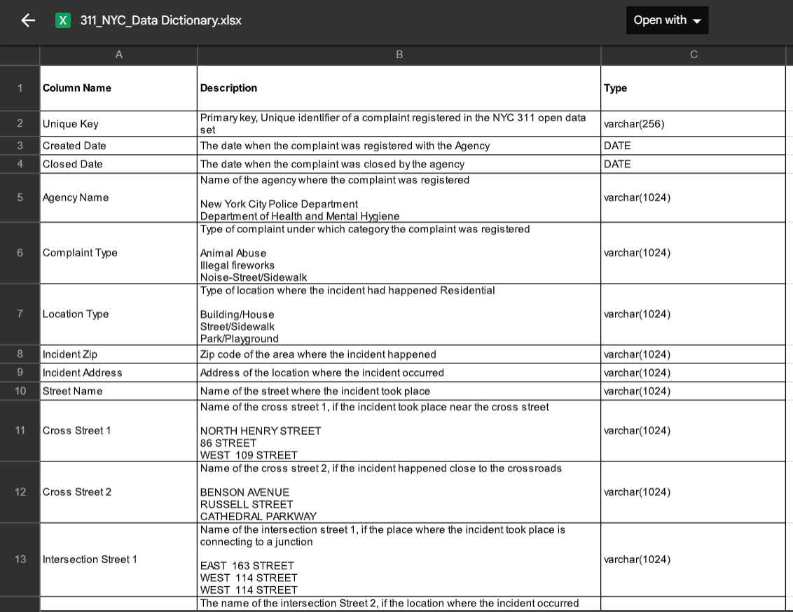
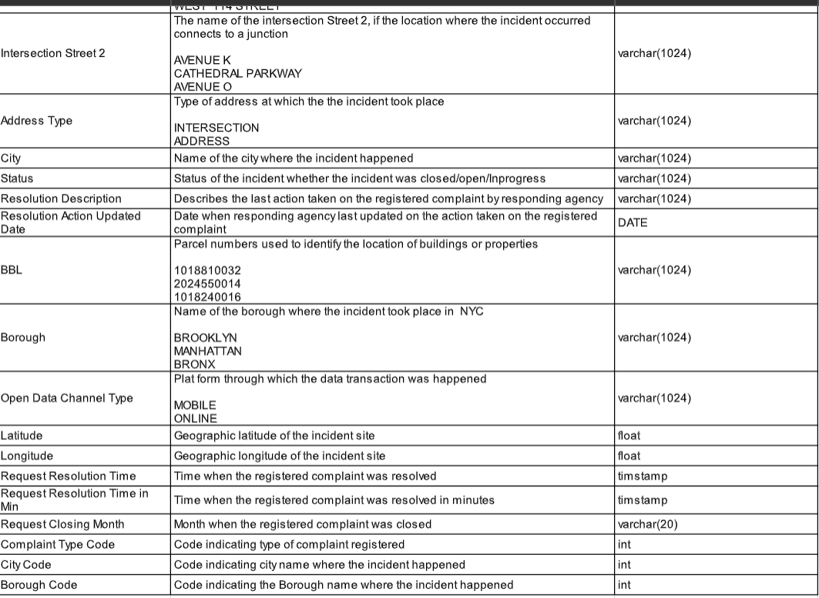
DATA DICTIONARY

Slide 10
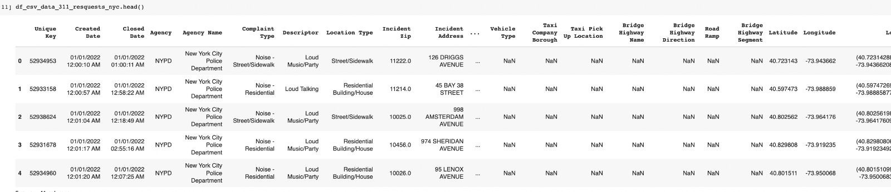
DATASET

Slide 11
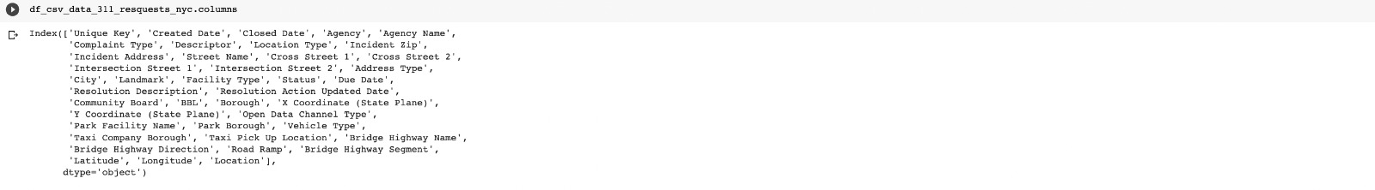
COLUMNS

Slide 12
MERGING TO DATA FRAMES

Slide 13
UTILITY PACKAGE

Slide 14
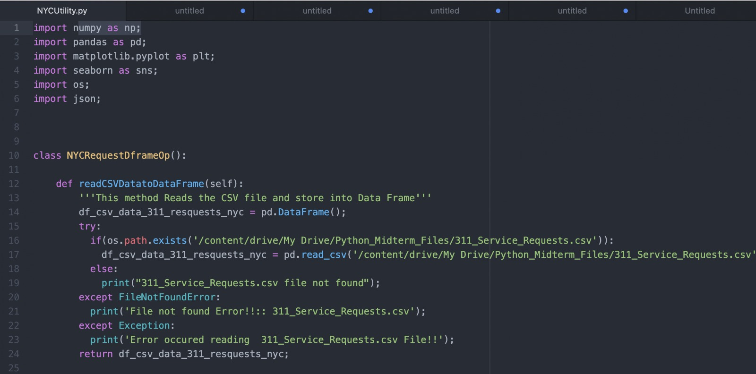
NYC UTILITY PACKAGE

Slide 15
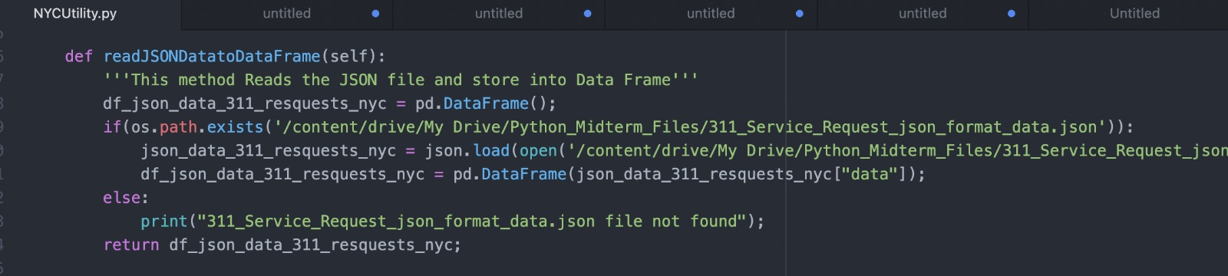

Slide 16
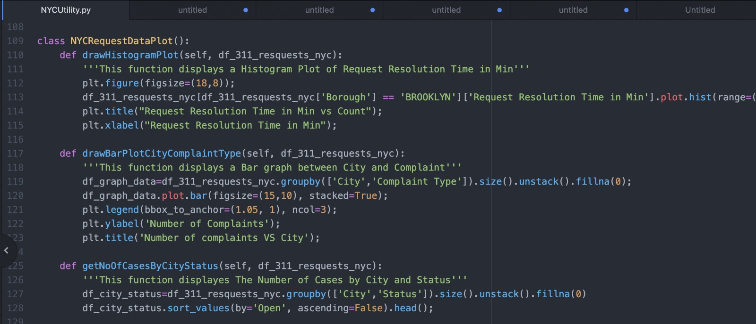

Slide 17
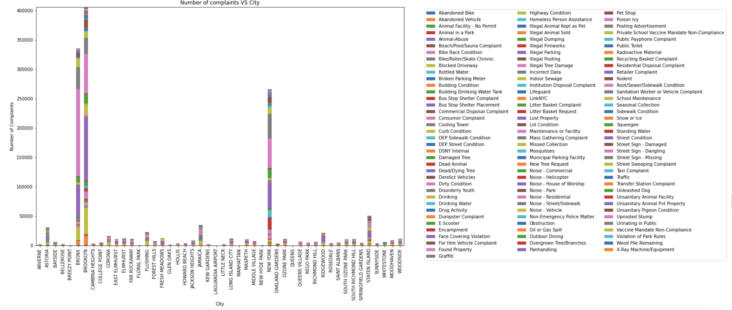
VIZUALIZATIONS and results
City with maximum number of complaints was found to be Brooklyn with different types of complaints

Slide 18
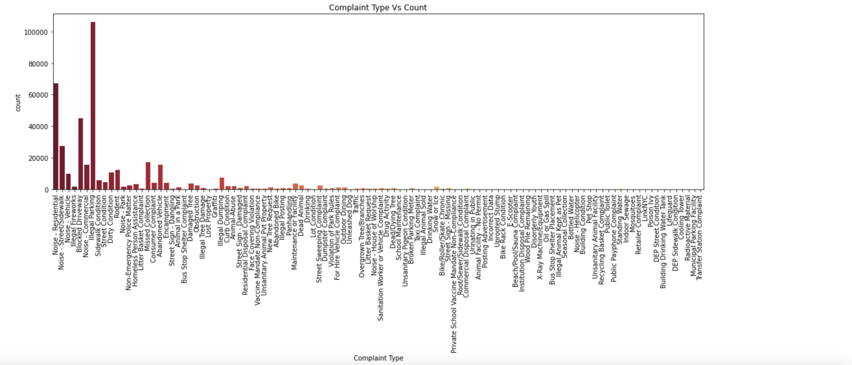
Since maximum number of complaints were filed in Brooklyn, complaint data was analysed for this city. Illegal Parking was found to be the most frequent complaint lodged to NYPD in the city of Brooklyn.

Slide 19
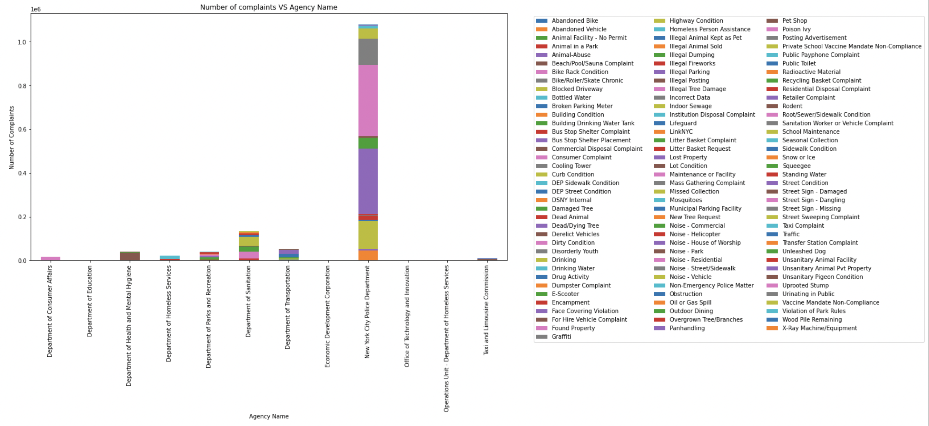
It was found that all the complaints were lodged to New York City Police Department

Slide 20
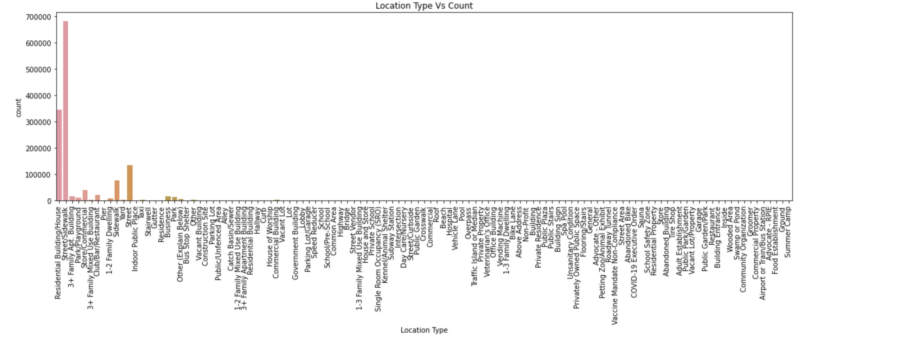
The maximum complaints were regarding Street/Sidewalk which indicate that there is a scope for improvement in strict measures on the road thus Traffic police can look into this matter

Slide 21
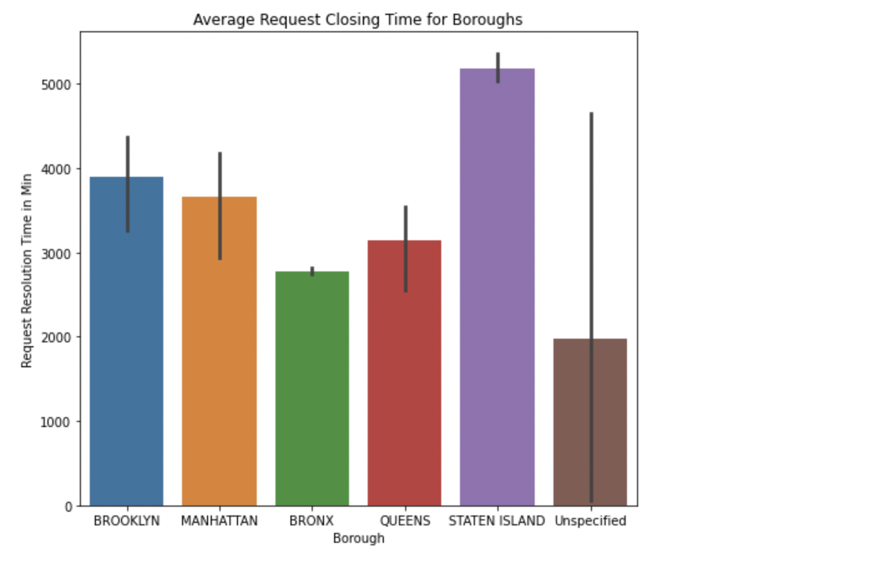
Average resolving time of a complaint was observed for different Boroughs

Slide 22
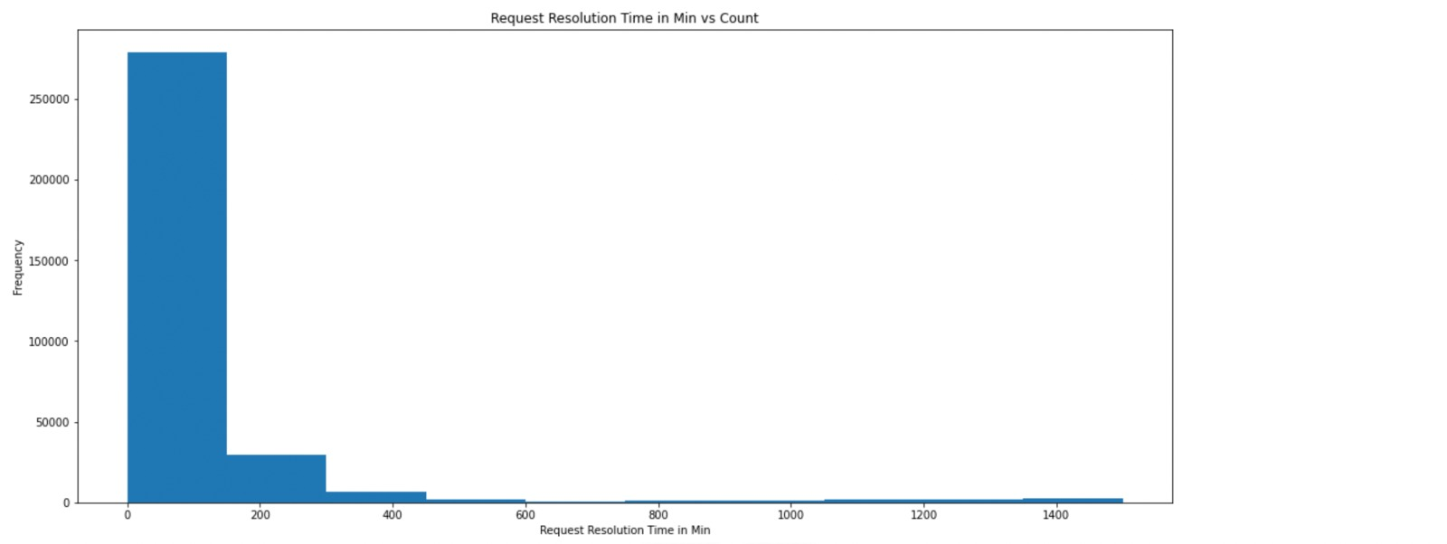
HISTOGRAM
Data frequency fluctuation is shown using a histogram. The chosen range of the request time and request count is displayed here using it.

Slide 23
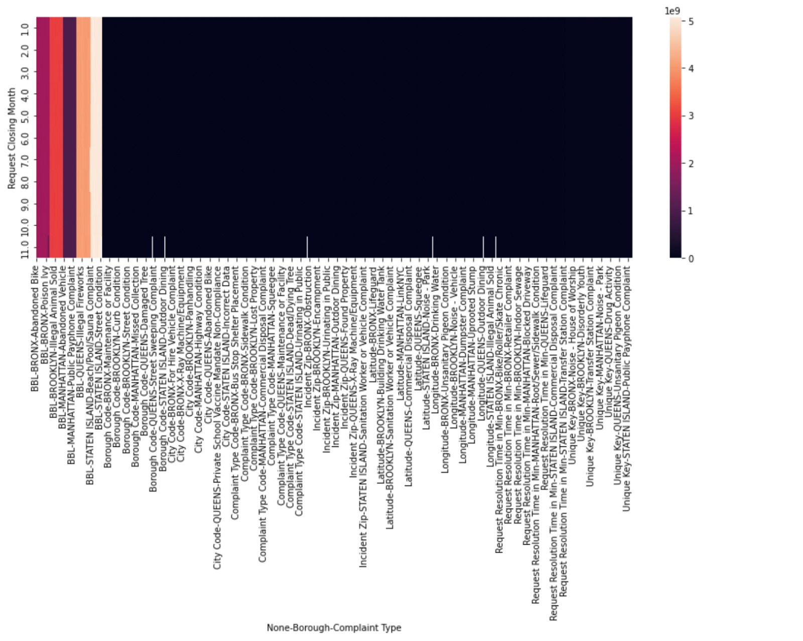
HEATMAP
For each value to be plotted, a heatmap has values that represent distinct tints of the same color. High frequency is represented on the chart by the darker tones. This demonstrates the association between the request's final month and the borough's type of complaint.

Slide 24
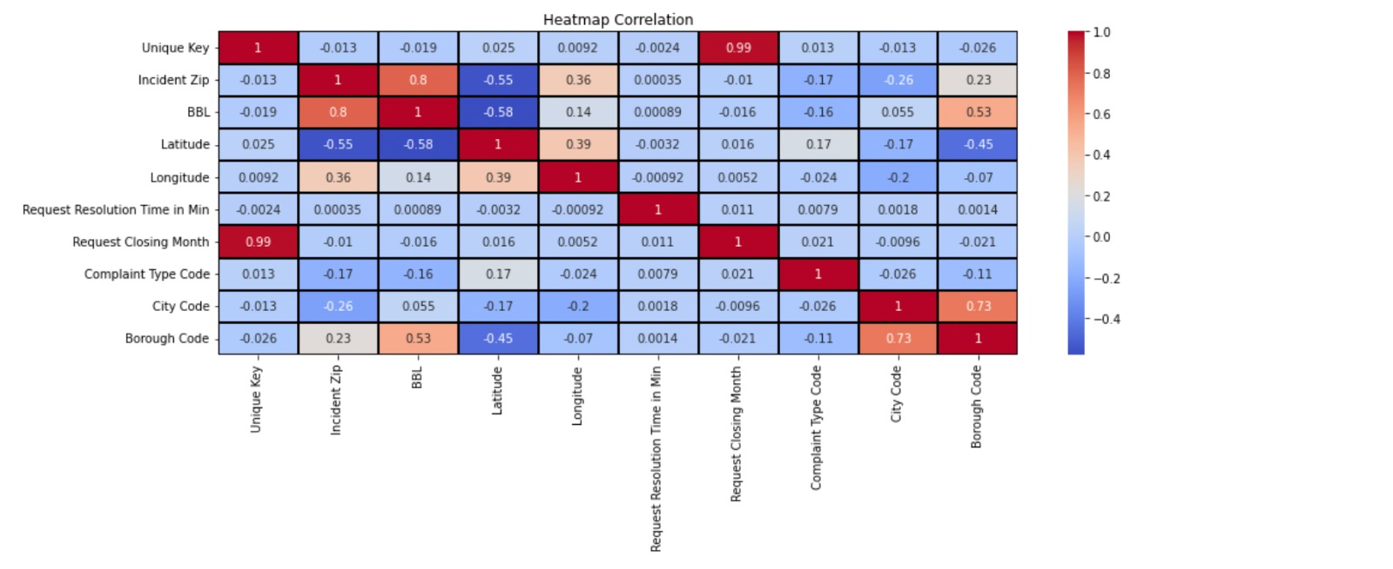
HEAT MAP
For each value to be plotted, a heatmap has values that represent distinct tints of the same color. High frequency is represented on the chart by the darker tones. This demonstrates the correlation between all the columns.

Slide 25
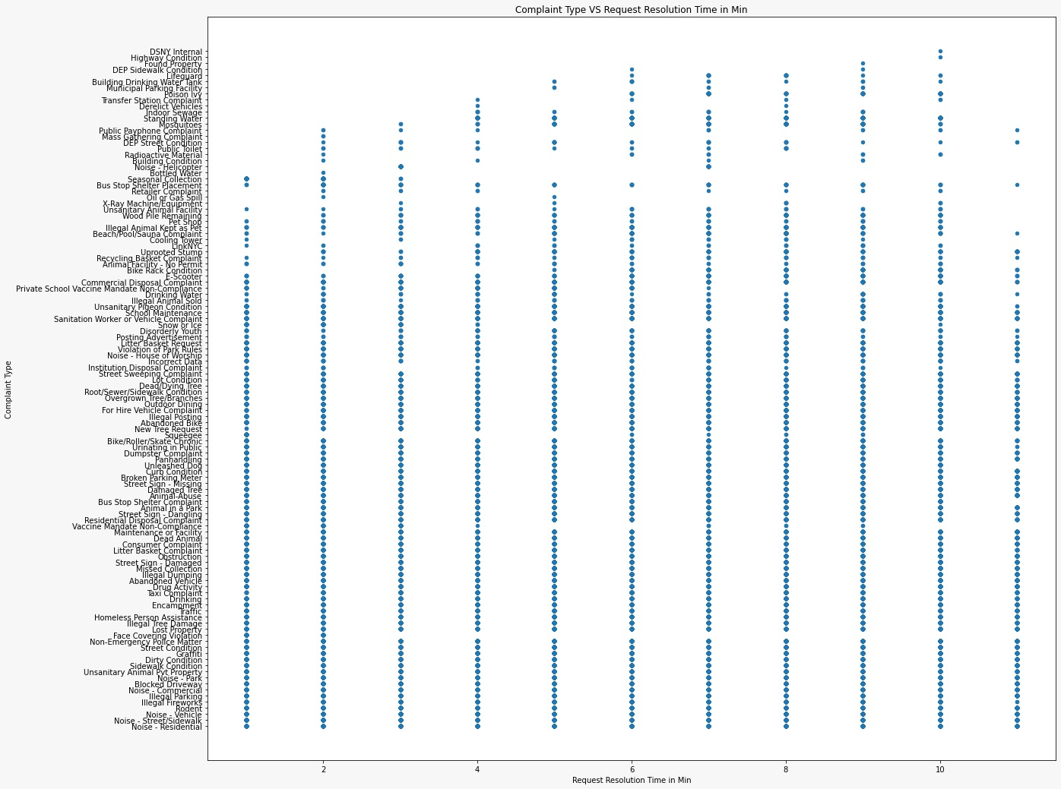
SCATTER PLOT
Two sets of data are compared along the two axes using a scatter plot. It helps to depict how the two variables are related to one another. Here, we've used it to illustrate the relationship between the type of complaint and the Request resolution time in minutes.

Slide 26
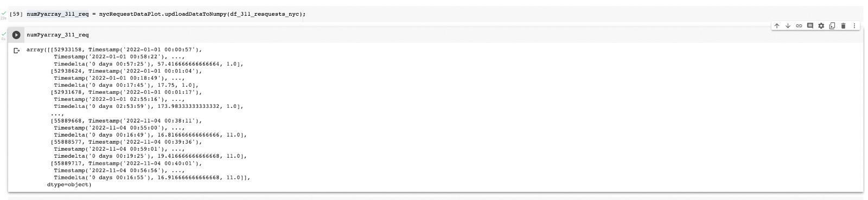
UPLOAD DATA TO THE NumPy

Slide 27
CONCLUSION
Using the datasets for the 311 Requests NYC we tried to find the variation in the complaints registered, complaints lodged agency,location, time taken to resolve the complaints and also from this analysis we got to know that the maximum complaints were regarding Street/Sidewalk which indicate that there is a scope for improvement in strict measures on the road thus Traffic police can look into this matter and also this analysis helps the government to concentrate on the areas or the locations where most of the incidents are happening.

Slide 28
REFERENCES
https://data.cityofnewyork.us/browse?q=311
https://www.geeksforgeeks.org/python-seaborn-tutorial/?ref=lbp

Slide 29

Thank you

